Slide 1
Production Function
Technological relationship between input (i/p) and output (o/p) is Production function.
Q (output) = f (Land, Labour, Capital, organization)
Labour (L) + Capital(K) combination intrinsically depends on technology.

Slide 2
Types of Production Function:-
Cobb Doglas production function:-
Q = L K
If Alpha + Beta = 1 then,
% increase in i/p = % increase in o/p
i.e. Constant returns to scale
If Alpha + Beta is greater than 1 , it is Increasing returns to scale
If Alpha + Beta is less than 1 , it is decreasing returns to scale

Slide 3
Labour Intensive Vs Capital Intensive industry
If Q = L K
It means, It is a labour intensive industry, as ratio of L and K is 2:0.5. Labour is more in proportion.
Generally, Manufacturing industry employees more labour.
Where as, service industry employees less workers.

Slide 4
Types (Contd………………………..)
2. C.E.S. Production Function:-
Different types of i/p-
Fixed i/p Variable i/p
Land Capital
Machinery Labour
Infrastructure

Slide 5
Short run Production Function:-
Law Of Variable Proportion:-
In short run there are certain fixed i/p as well as certain variable i/p.
Eg:- Agricultural Land- Fixed i/p
Labour- Variable i/p

Slide 6
Land Labour total productivity-
Land | Labour | Total Productivity
Fixed | 1 | 10 units | Stage I
 | 2 | 20 units
 | 3 | 27 units | Stage II
 | 4 | 30 units
 | 5 | 30 units | Stage III
 | 6 | 27 units | Stage IV

Slide 7
Stage I:- Total Productivity (TP) Increases at increasing rate while cost increases at decreasing rate.
As cost = TP/Output
Stage II:- TP Increases at decreasing rate and cost increases at slighter increasing rate.
Stage III:- TP is constant while cost increases with high rate of increase.
Stage IV:-TP decreases so cost increases drastically.
One must try and work in Stage II

Slide 8
Marginal Productivity is 0 at point where TP is max. In Stage III Marginal productivity moves towards –ve.

Slide 9
Long Run Production Function:-
Law of Returns to Scale:-
In long run production function there are only variable inputs.
Types:-
Law of constant returns to scale
1% increase in i/p= 1% increase in o/p
b) Law of increasing returns to scale
1% increase in i/p leads to 2% or more increase in o/p
c) Law of decreasing returns to scale
1% increase in i/p leads to 0.5% increase in o/p

Slide 10
Cost (Classification)
Accounting Cost- Also known as Explicit Cost. A cost which one can see. Ex: Cost of raw material, Transportation, Labour cost etc
Economic Cost= Explicit Cost + Implicit Cost
Implicit Cost- A cost which one can not see. Ex. Spending of Time, Mental Peace etc
It one can cover Explicit as well as Implicit Cost then and then only the business is viable.

Slide 11
Business Cost- It does not include depreciation (decrease in the selling price as compare to the original selling price) of machine, land rent, interest on loans etc.
Full Cost= Business Cost + Depreciation Cost
Short Run (A period of less than 1 year) includes 2 types of costs-
Fixed Cost- Land, Machinery, Infrastructure, Salaries to Top managerial people.
Variable Cost- Cost of raw material, wages
(Semi variable cost) phone bill, Electricity bill etc.

Slide 12
Opportunity Cost- Next best alternative which you can have.
Incremental Cost- Cost required to expand the business. It varies with the range of options available in the decision making process.
Sunk Cost- Cost which one can not recover after investment. Ex: Passing of time, R&D cost if product fails etc.

Slide 13
Short Run relationship between Production and Cost
Total Cost=Fixed Cost + Variable Cost
Average Cost= Total Cost / Quantity
= TC / Q
Marginal Cost = dTC / dQ
= Change in total cost/change in output
Marginal Cost- Cost required to produce n products in place of n-1 products
Ex. For 10 units- Rs. 5000
For 11 units- Rs. 5100
MC= 5100-5000/11-10
= Rs 100

Slide 14
Types of Profits
Gross Profit- Total amount of sales from selling goods is known as Gross Profit.
Net Profit- Money left after deducting all cost endured.
Gross Profit – Costs = Net Profit

Slide 15
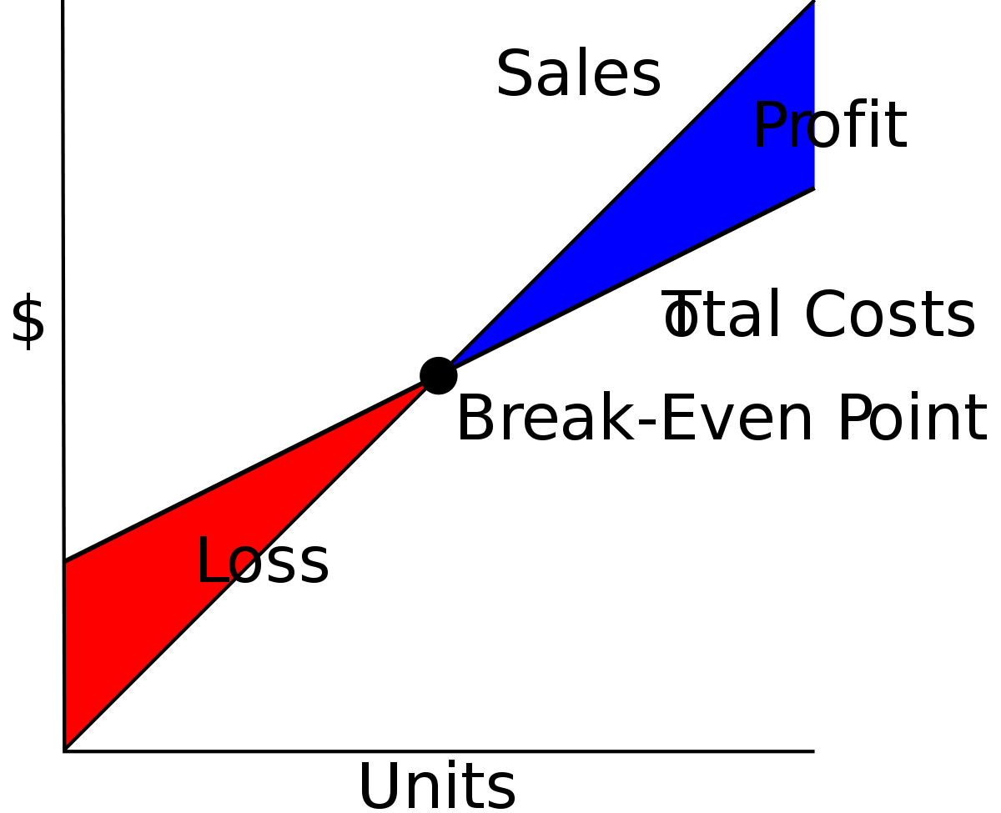
Break Even Point (BEP)
BEP= No profit no loss condition
Price
No Of
Notes:
BEP= No profit no loss condition

